Slide 1
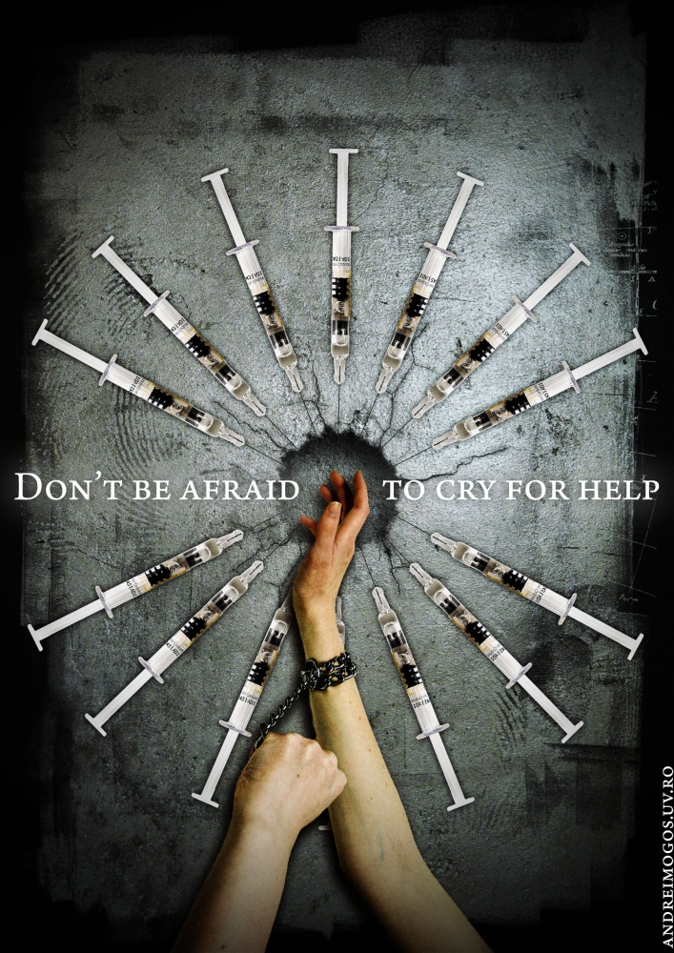
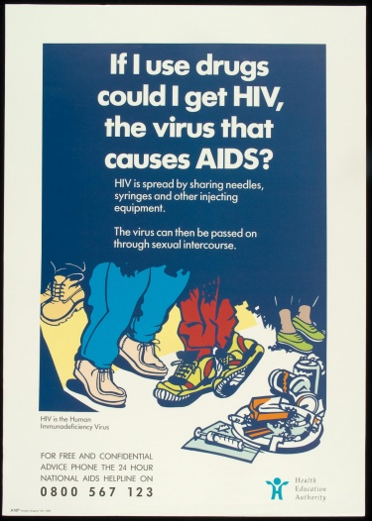
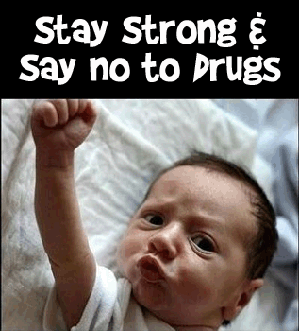
Creating Persuasive Evidence-Based, Anti-Substance Use
Media Messages
William D. Crano, PhD
Professor of Psychology & Director,
Health Psychology and Prevention Science Institute
Claremont Graduate University
Rees Kofi Oduro (Ghana)
Portia Gaone Diteko (Botswana)

Slide 2
The Issues
-Mass Media have been irregularly successful in prevention of psychotropic substance use.
-Successful campaigns are good value.
-Failed campaigns are intolerably expensive.
-Inevitably, failed campaigns have ignored evidence, and used unpersuasive preventive communications

Slide 3
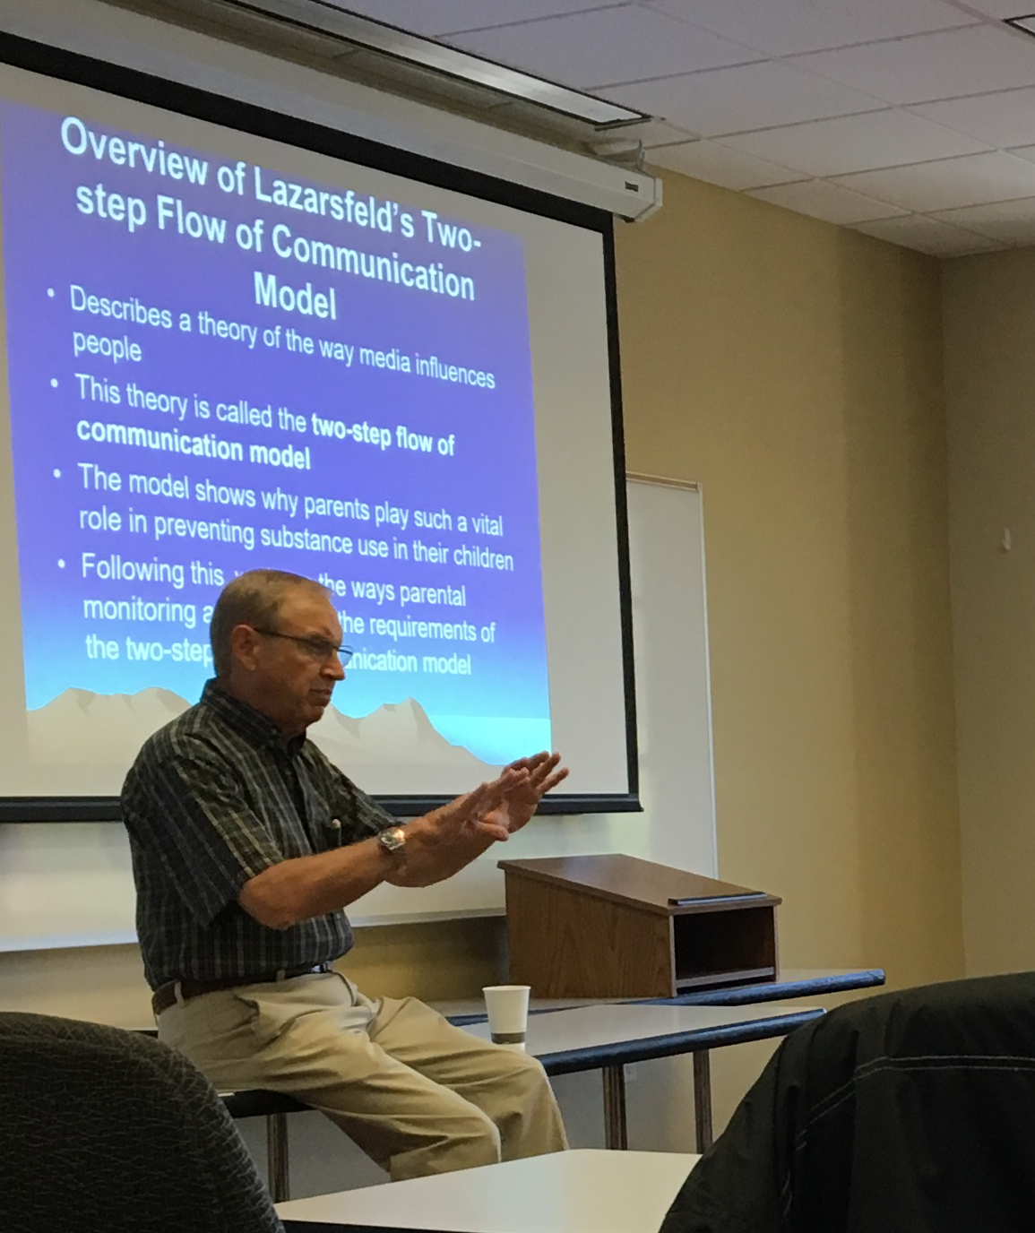
Our solution: The EQUIP Model, which integrates critical media and persuasion requirements
EQUIP highlights the key design features for successful media-based persuasion
It is based on a strong and well-established evidence base

Slide 4
The Central Action Components of the EQUIP Model
Engage: Attract and maintain attention of your audience
Question: Raise question in mind of receiver about their pro-drug attitude
Undermine: Destabilize the attitude
Inform: Provide plausible replacement of existing belief
Persuade: Provide incentives for agreement with your message

Slide 5

Let’s use EQUIP to review a memorable ad from an early media campaign in the U.S.

Slide 6
Let’s Evaluate the Ad using EQUIP
  ENGAGE: Did it attract people’s attention? Yes, initially.
  QUESTION: Did it raise a question in viewers’ minds? No.
  UNDERMINE: Did it threaten existing beliefs & provide alternative? No.
  INFORM: Did it tell you how to avoid frying your brain? No.
  PERSUADE: Was it persuasive? No. It is telling me to avoid a drug, but not how to do it, or why I should… It will fail.
BUT, Americans remember the ‘this is your brain on drugs’ ad!
Notes:
There is a difference between an ad’s memorability and its persuasiveness. This ad was memorable – but not persuasive.
This was a creative and memorable ad that satisfied only one of the EQUIP criteria - ENGAGE. As we might expect, evidence showed it had no preventive effect.

Slide 7
Important working assumptions
Adolescents do not always believe what they are told, especially when dealing with psychotropic drugs.
We need to overcome their resistance to attain positive preventive effects
The first and major consideration: expect counter-arguments
The EQUIP can help overcome these defensive reactions
Notes:
There is considerable literature, built up over the past 6 decades that suggests what to do and how to do it
This literature fits perfectly with our EQUIP requirements, and facilitates our attempts to integrate preventive media with persuasion

Slide 8
Building on the EQUIP, when designing our persuasive message, we:
Make resistance difficult, impossible, or apparently unnecessary
Target or tailor the persuasive message to the susceptibilities of the audience
When dealing with adolescent audiences: Engage parents – they are credible sources and they want to help

Slide 9
Reprise: What media-oriented prevention specialists and policy makers should do to mount a successful campaign
Work to overcome resistance to your appeal by:
  Engaging your audience
  Questioning existing (pro-drug) attitudes
  Undermining this answer
  Informing –attitudes are affected by information derived from strong messages
  Persuading – incentivize adoption of your answer – show why your message should be accepted

Slide 10
More specifics…
Do not over-promise or over-threaten:
  Fear arousing ads usually fail – Avoid them
  Unbelievable ads usually fail – Avoid them
  Exaggerated ads usually fail – Avoid them
  Whimsical ads usually fail – Avoid them
  Current failures result in future failures by reinforcing resistance
  For youth campaigns, involve parents as opinion leaders, if possible
If not possible, make it possible

Slide 11

In Claremont Graduate University’s Advanced Certificate in Media-Based Prevention (2018), we taught these principles
Claremont faculty (Prevention Science, Social Psychology, Health Communication)
3-Weeks at CGU – 3 intensive courses
3-Month Distance Course (UPC-I Media)
Practicum

Slide 12

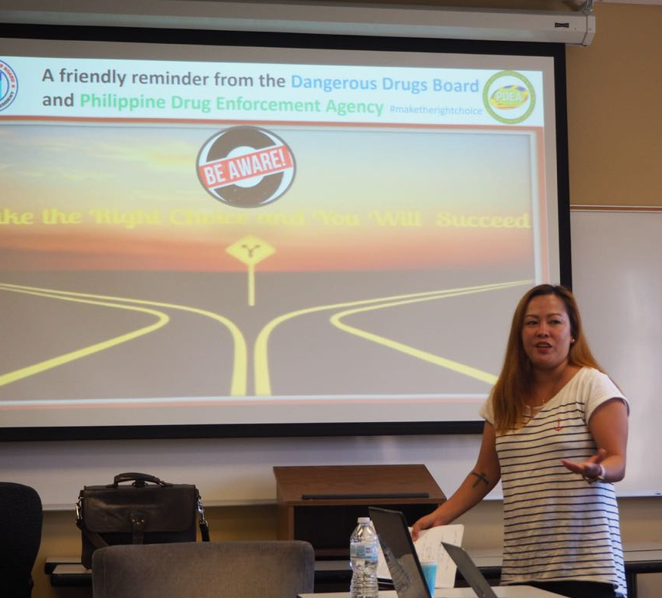
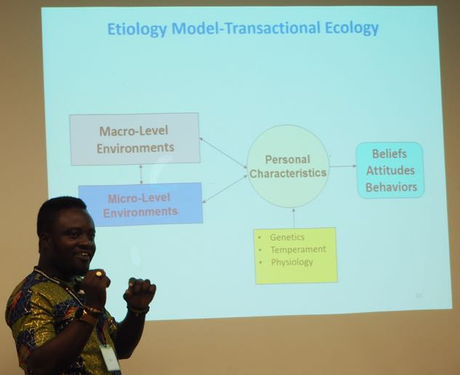
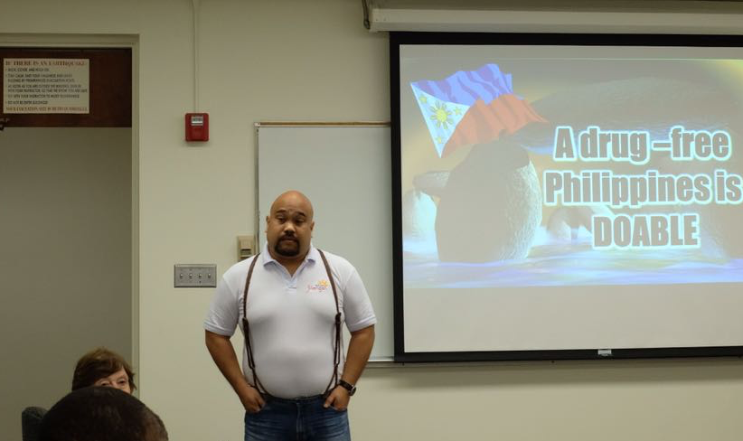
And now you will hear from our 2018
Claremont Graduate University
Advanced Certificate Graduates from Botswana and Ghana

Slide 13
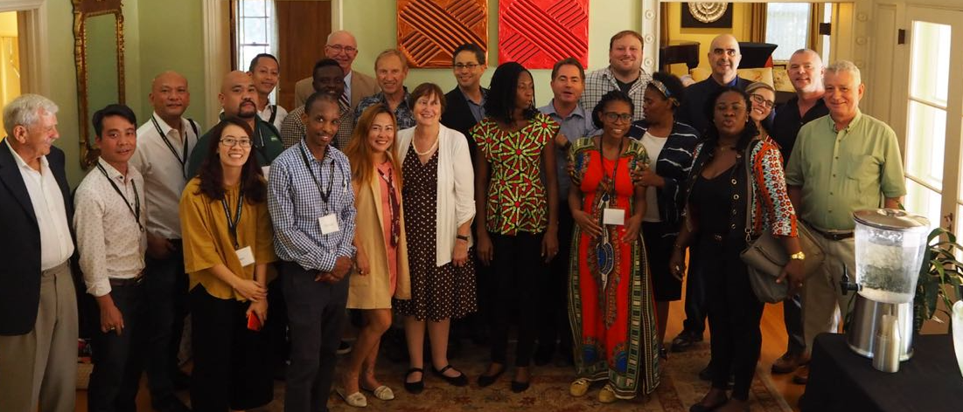
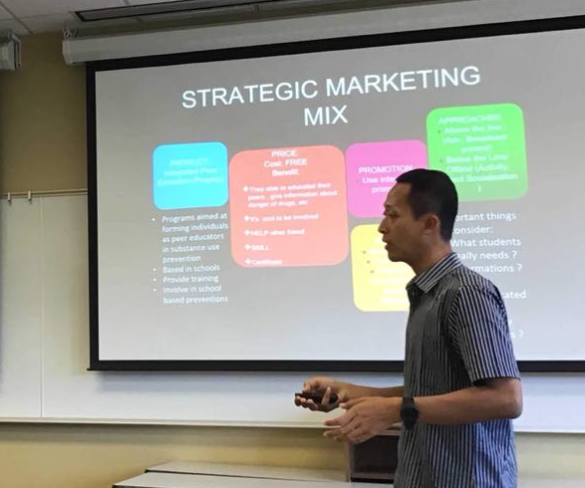
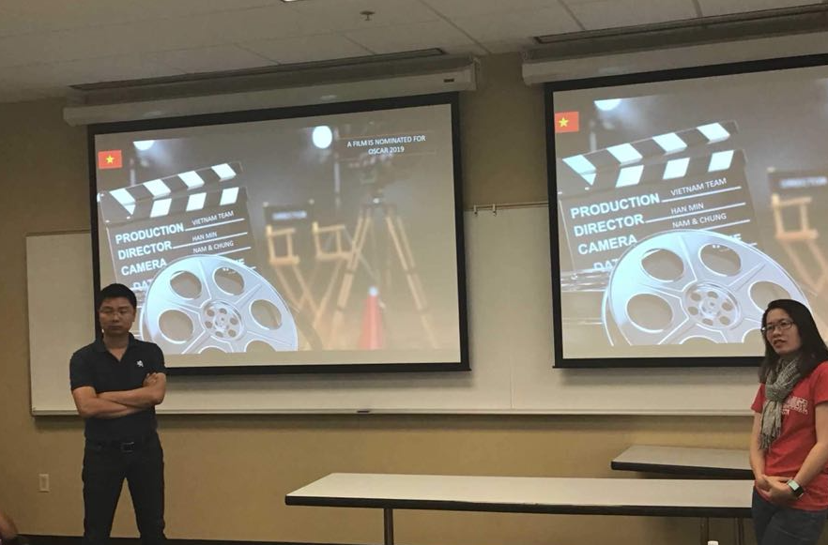

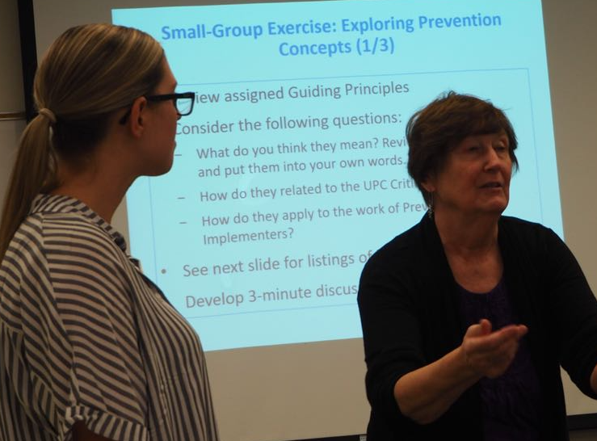
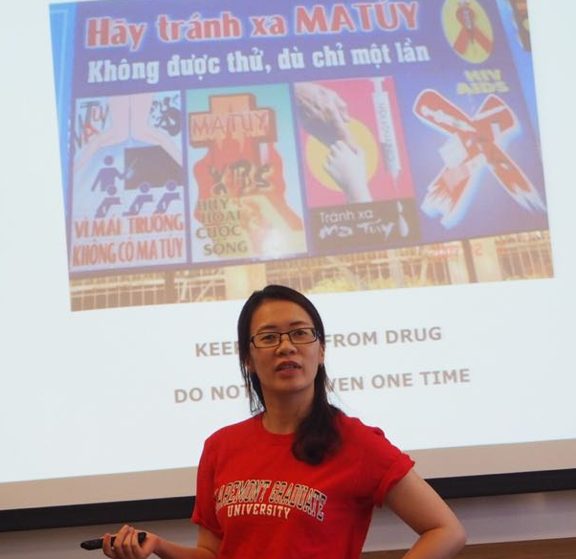
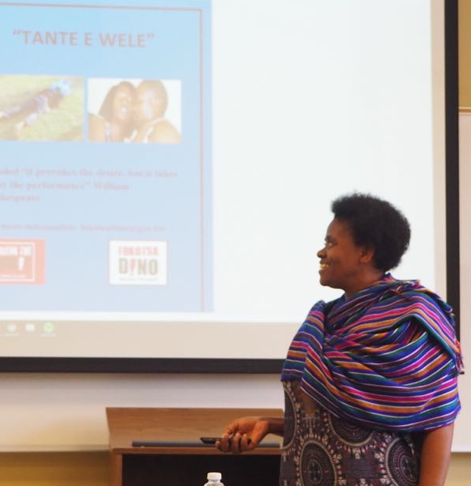
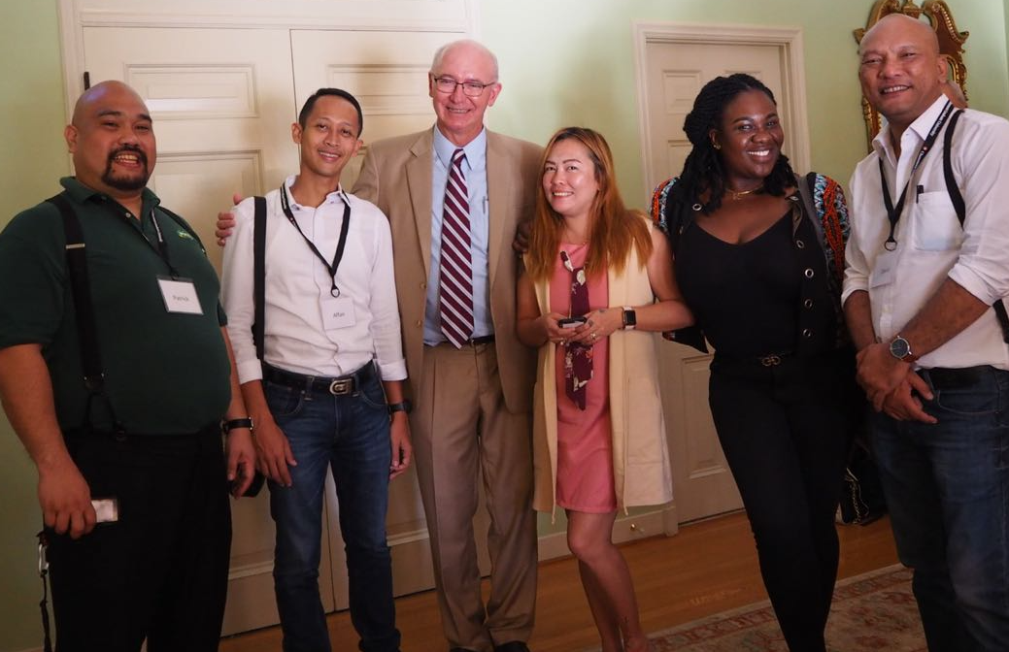
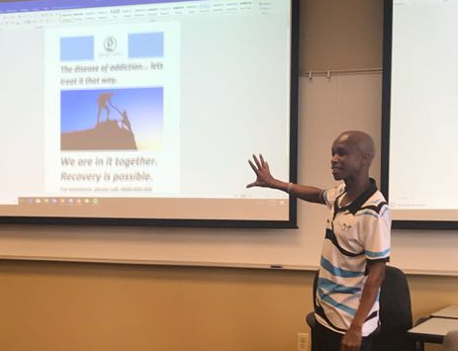

Slide 14
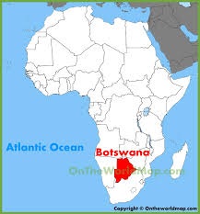
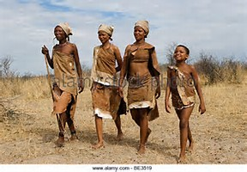

Portia G Diteko
Use of media campaigns to prevent excessive alcohol use among youth aged 18 to 35 in Selebi Phikwe during the Phikwe EXTRAVAGANZA

Slide 15
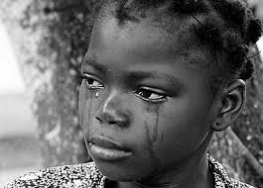

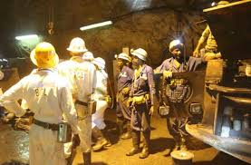

overview
2016 Selebi Phikwe Mine Close- thousands of people lost JOBS Excessive alcohol use to cope; source of income- acceptance, accessibility, availability
Efforts to Help the situation become Potential to harm- Phikwe Fest- police reports link to incidents to excessive alcOhol use
Prevention science intervention

Slide 16
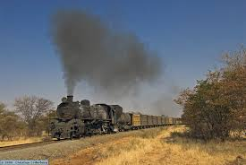
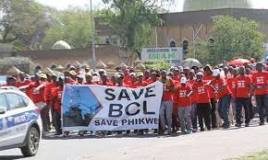
Overview cont’d.
Those who were left behind
The things that were meant to help them but had the potential to harm them
And how media based prevention science could intervene

Slide 17

Scope of alcohol use
Public health concern
Global (3 million deaths- 1 in 20 people)
African highest prevalence 57.1% youth aged 20-24
Botswana: 7.9 to 10 litres per capita
Selebi Phikwe-economic crisis, HIV Prevalence, Festivals
Notes:
Public health concern- 3 million deaths 1 in 20 people

Slide 18
Aim
Use of media campaigns to prevent excessive alcohol use among youth aged 18 to 35 in Selebi Phikwe during the Phikwe Festival

Slide 19
RATIONALE
Needs Assessment- COMMUNITY PITSO- FOCUS GROUP DISCUSSION Results
-entertainment events in the community are meant to help, but have the potential to harm
-Consistent with global literature
POLICE REPORT- Urban Development Committee
Defilement/HIV/Unplanned Pregnancies
-Theft/Robbery
- Injuries/fatalities-accidents, fights
- Financial constraints- domestic violence, work problems, loans
- Cyber bullying

Slide 20
Theoretical Foundation
Attitude Ambivalence model
Excessive alcohol use
- tive Linked to defile-ment
-tive
Waste my money
-tive linked to accidents
+
gives confi-dence
+
increase social status
-tive Linked to theft

Slide 21
Campaign
3 stage campaign
Inform
Persuade
Increase efficacy

Slide 22
Stage 1
Message
What DOES excessive alcohol use Mean?
Why am I at risk?
Platform
Message 1 A- Social Media Flyer posted on Event page
Duration- starting when Festival is advertised to the day of event
Theory
Health Belief model
Hovland’s Learning Theory
Theoretical components
susceptibility
Cues to action
Distraction

Slide 23
Stage 2
Message
Challenge Existing Attitudes Towards Excessive Alcohol use
Increase negative attitudes towards excessive alcohol use
Platform
Message 1 A- Flyers, ace App
Theory
Theory Of Vested Interest
Theoretical components
Salience
Immediacy
Certainty

Slide 24
Stage 3
Message
It is possible to avoid Excessive alcohol use
Platform
Flyers at strategic places At the event
Bulk sms
Theory
Health Belief model
Hovlands Learning Theory
Theoretical components
Expansion
Self- Efficacy

Slide 25
Implementation Procedure
Stage | Task | Status
Stage 1 | Community needs assessment | complete
Stage 2 | Message development | complete
Stage 3 | Partner With Event Organisers | complete
Stage 4 | Pilot Test | Ongoing
Stage 5 | Implement
Stage 6 | Evaluate

Slide 26
PILOT Test
50 participants
Convenient sampling, Event and Town Facebook page, snowball
Criteria - did you drink?, did you attend last year?
Attitude Assesment- Semantic differential Form
consumption assessment- Alcohol Use Identification Disorders Test Consumption questionnaires
randomly assigned control group- no exposure to message
randomly assigned experi-mental group
After Event- Assessment attitude and consumption assessment
After Event- Assessment attitude and consumption assessment

Slide 27
Pilot test results
50 partici-pants
………Male
......Female
……Average age
Attitude Assess-
ment ………………
Consump-tion assess-ment…………….-
randomly assigned control group- no exposure to message
randomly assigned experi-mental group
After Event- Assessment attitude and consump-tion assess-
ment…………………
After Event- Assessment attitude and consump
-tion assess
ment…………..
Findings/ recommend-ations

Slide 28
CONCLUSION
Those who were left behind
The things that were meant to help them but had the potential to harm them
And how media based prevention science could intervene

Slide 29
PREVENTING MARIJUANA USE AMONG GHANAIAN TEENS
A PARENT-TARGETED APPROACH
BY:
REES HAKEEM ODURO

Slide 30

THE PROBLEM - MARIJUANA USE IN GHANA
Marijuana is the most commonly abused psychoactive illegal substance in Ghana (Brown-Acquaye, 2001)
  Average age of first use: between 10 and 12 years of age
  Reason for initiation = Experimentation
Parental involvement (coming from a dual-parent family) reduces teen rates of marijuana use (Doku, Koivusilta, & Rimpelä, 2012)
  Social position (plans after graduation) were strongly associated with marijuana use
    Use was highest among students that did not plan to continue their education
Notes:
Brown-Acquaye, H. A. (2001). Drug abuse among the youth in Ghana. African Journal of Educational Studies in Mathematics and Science, 1, 115-120.
Doku, D., Koivusilta, L., & Rimpelä, A. (2012). Socioeconomic differences in alcohol and drug use among Ghanaian adolescents. Addictive Behaviors, 37(3), 357-360.

Slide 31
TARGET AUDIENCE
Parents of vulnerable (Adolescents) non users
Vulnerable (Adolescents) nonusers: someone who has not used the substance, but is open to using in the future.
  Open and ambivalent about use - have both positive and negative beliefs
  Can be resistant to anti-marijuana messages
Crano, Siegel, Alvaro, Lac, & Hemovich (2008)
Notes:
Vulnerable nonuser
•Someone who has notused a substance, but does NOT say they will definitely not use in the future
•They are open to use
The next category is a Vulnerable nonuser. Again, in common terms and in the substance use literature, there are many ways to think about people who are ‘vulnerable’. Generally speaking, calling someone ‘vulnerable’ may mean that that person is ‘at-risk’. According to the Tripartite user status classification, like the resolute nonuser, a vulnerable nonuser is someone who has never used a substance. However, vulnerable nonusers are notcommitted to remaining nonusers. Specifically, vulnerable nonusers do notsay that they will definitelynotuse in the future. You can think of them as being somewhat open to some kind of use in the future. They may not be seeking use but they are not entirely against it either. This approach to categorizing differs somewhat from the usual “at risk” definitions, which use demographic features (poverty, normative usage, status) to define an individual as being at risk.
Let’s now look at the second group; Vulnerable nonusers. As we noted, these receivers have never used the substance we are concerned about. Thus, the ultimate goal is the same as that for the Resolute nonusers – to prevent initiation of substance use. We want to keep them from starting use for as long as possible. As with the Resolute nonusers, we also want to reinforce non-use among receivers who are Vulnerable nonusers. However, we also want to help them resist the motivation to use. By definition, they are open to some use and this openness needs to be minimized.
The main idea in regards to Vulnerable nonusers is that they are open to or ambivalent about use. This means that they may have both negative and positive beliefs about using. The answers to the questions is that these beliefs can impact on the ways they respond to messages. They may be open to messages that they believe in but they may also oppose messages that target things they do not believe in. Also, they may have family and friends who are users and, as they are open to use, if pressured or given an opportunity to use, they may succumb to substance use. This also means that they may have been around use and know the facts about users so you have to be careful to present realistic information that is not contrary to their own experiences. In other words, do not exaggerate your claims to foster you (prevention) aims. Finally, you do not want to reinforce all their beliefs. They are ambivalent, so you need to find out which pro-substance beliefs they hold and address those.
Crano, W. D., Siegel, J. T., Alvaro, E. M., Lac, A., & Hemovich, V. (2008). The at-risk adolescent marijuana nonuser: Expanding the standard distinction. Prevention Science, 9, 129- 137.

Slide 32
EQUIP MODEL, THEORY OF PLANNED BEHAVIOUR (TPB) & TWO STEP FLOW MODEL
EQUIP MODEL
ENGAGE
QUESTION
UNDERMINE
INFORM
PERSUADE
THEORY OF PLANNED BEHAVIOUR
ATTITUDES
SUBJECTIVE NORMS
PERCEIVED BEHAVIORAL CONTROL
INTENTION
BEHAVIOUR
TWO STEP FLOW MODEL
OPINION LEADERS
OPINION FOLLOWERS

Slide 33
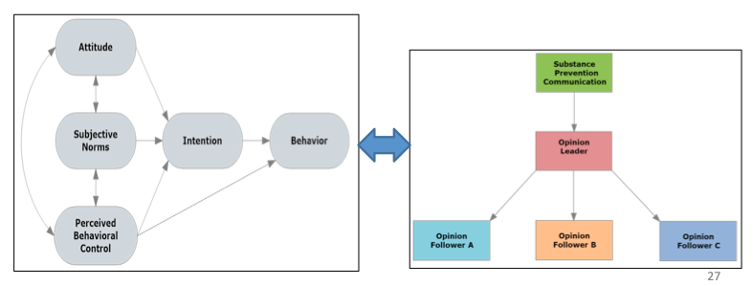
INTEGRATING THE TPB & TWO-STEP FLOW
Opinion leaders (parents) can impact opinion followers (adolescents) norms, attitudes, and perceived behavioral control which will affect their intensions and predict their behavior.
Notes:
Two Step Flow
• Opinion leaders influence how people think about an issue which affects the attitudes of their followers.
• Opinion leaders reinforce group norms, thus affecting subjective norms
• Opinion leaders can encourage followers to believe in their capacity to perform needed actions
The two-step flow can affect the major components of the TPB. The TPB provides extremely useful insights into the process of how people’s attitudes may affect their behaviors. But it is not specific about how to affect the important component parts of the TPB’s attitude-intention-behavior sequence. The two-step flow model provides useful insights into how the TPB can be made to work most efficiently.
Integrating these two theories provides guidance for media specialists, leading to more effective prevention outcomes.
The most obvious link of the two-step flow with the TPB is in its relation to subjective norms. This feature of the TPB is concerned with the individual’s perceptions of what significant others think he or she should do with respect to a given issue (e.g., engage, resist, or desist in use of a substance). The two-step flow model identifies these significant others as opinion leaders. There’s a direct, one-to-one relation between significant others and opinion leaders. In addition, the leader’s position tends to standardize norms within a group, thus leading to development of shared norms, which guide group members’ actions.
The attitude component also is a focal issue of both theories. The two-step flow model indicates that opinion leaders have much to do with how a persuasive prevention communication affects their followers’ attitudes. The opinion leader’s commentary on the content and form of a media message is a major predictive factor of the effect of a communication. When the opinion leader transmits ideas to opinion followers, this action has a strong effect on their followers’ attitudes. Of course, this requires that the opinion leader have strong credibility, which we will discuss in tomorrow’s lesson.
The two-step flow of communication also interacts with the TPB when the role of perceived behavioral control is considered. The opinion leader can play a powerful role in motivating opinion followers to believe that they have the capacity to act on the advice provided in a persuasive substance-prevention communication.
The effect of social support has been established as a powerful adjunct to good (or bad) behavior. The opinion leader can strongly reinforce the message presented in a preventive media communication, thereby reinforcing followers to absorb, consider, and act on the advice provided. It is through the opinion leader that the follower gains confidence and motivation to follow the prevention guidance provided in the media message.

Slide 34
APPROACH
By what means will the campaign reach out to the target audience?
FLYERS
BILLBOARDS
POSTERS
AUDIOVISUALS
SOCIAL MEDIA (FACEBOOK, YOU TUBE, WHATSAPP…)

Slide 35
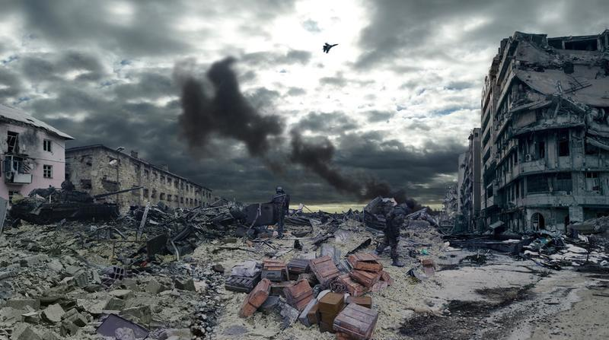


PARENTS
Is Your Home
a War Zone
Or
a Peace Camp?
Research shows that teens who use marijuana are less likely to be successful in the future.
Teens from warm and supportive environments are less likely to use marijuana.
Tips for PARENTS:
Talk to your child about the dangers of marijuana use.
Create a safe environment.
LISTEN to your child.
Stay calm.
For more information on talking to your kids about the dangers of marijuana, visit: https://drugfree.org/resources/
6
Don’t Let Marijuana Control Your Child’s Future...
Notes:
Parental warmth ad

Slide 36

Parents, have a conversation, not a confrontation!
Tips for talking to your kids about marijuana:
Show your concern
Stay calm
Let your child know you appreciate his/her honesty
Show your love
Do not get defensive
Listen first
Finding out your child has been offered marijuana can feel emotional and confusing. But, it is important to stay calm when talking to your kids about drugs.
For more information about talking to your kids about the dangers of marijuana, visit: https://drugfree.org/resources/
7
Don’t Let Marijuana Control Your Child’s Future...
Notes:
Talking to kids about marijuana
Can we find videos about talking to kids about drugs

Slide 37

PARENTS, LET YOUR CHILDREN KNOW THAT TEENS WHO USE MARIJUANA ARE LESS LIKELY TO BE SUCCESSFUL IN FUTURE.
For more information about talking to your kids about the dangers of marijuana, visit: https://drugfree.org/resources/
9
Don’t Let Marijuana Control Your Child’s Future...
Notes:
Parental warmth ad

Slide 38
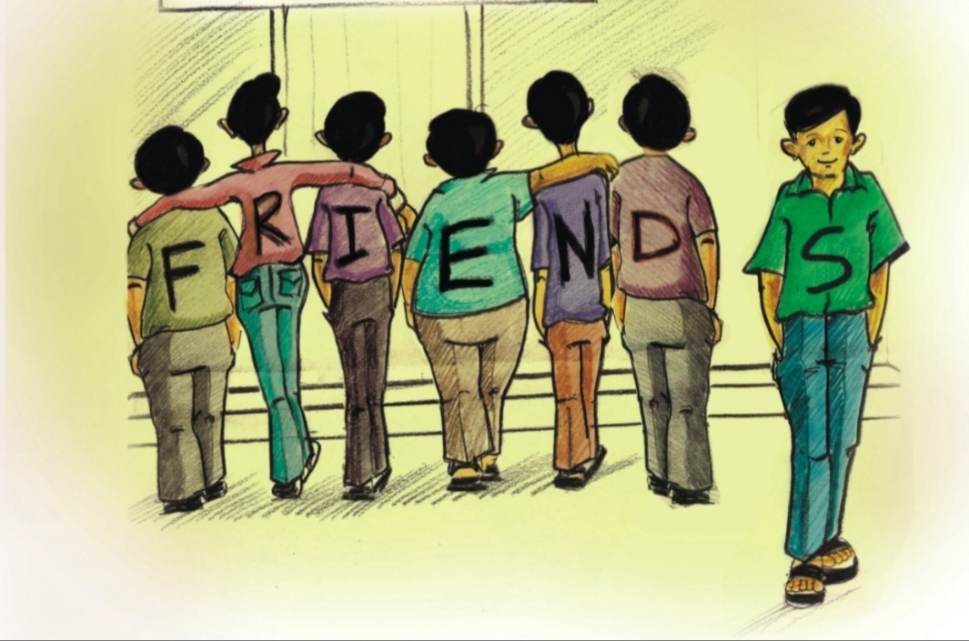
PARENTS TELL YOUR CHILDREN TO AVOID FRIENDS WHO PRESSURIZE THEM TO USE MARIJUANA.
SMART PARENTING TIPS #1
Let your child understand ‘it is a myth that most teens use marijuana’. The small percentage that use marijuana are more likely to drop out of school or have academic problems.
For more information about talking to your kids about the dangers of marijuana, visit: https://drugfree.org/resources/
10
Don’t Let Marijuana Control Your Child’s Future...
Notes:
This ad teaches teens to resist peer pressure. Also focuses on NORMS - most kids do not use marijuana
https://teens.drugabuse.gov/blog/post/6-tactful-tips-resisting-peer-pressure-to-use-drugs-and-alcohol
https://teens.drugabuse.gov/blog/post/resisting-peer-pressure

Slide 39
Logic Model
Resources
  Time
  Message Development
  Funds
  Personnel
  Available space
Activities (inputs)
  Intensive training
  Pre assess-ment and post assess-ment
  Focus Groups
Outputs
Changes in:
  attitudes, subjective norms, perceived behavioral control, intentions, behavior before and after campaign
  parent-child communication
  monitoring, warmth

Slide 40
EVALUATION PLAN
PARENTS AND ADOLESCENTS - Pre-Assessment
PARENTS PRE-ASSESSMENT
Parental Warmth & Monitoring
Intentions to Communicate with Children
How willing Parents are to talk to their children about Marijuana
Subjective Norms about Anti-Marijuana Communication
Attitude Toward Anti- Marijuana Child Communication
ADOLESCENTS PRE-ASSESMENT
Parental Warmth
Parental Monitoring
Marijuana Perceived Behavioral Control to Say “No”
Marijuana Subjective Norms
Marijuana Attitudes
Donaldson, Handren, & Crano (2016); Huansuriya, Siegel, & Crano, (2014)
Notes:
Pretest Assessment for parents - example items to be asked on slide
Attitude Toward Drug Communication
Parents rated the statement, “Discussing drug use over the next 6 months with (child name) would be ...” on three 7-point scale items. The endpoints of the three items were (a) extremely bad to extremely good; (b) extremely unpleasant to extremely pleas- ant; and, (c) extremely unimportant to extremely important.
Subjective Norms About Drug Communication
Parents were asked, “Think about the people who are important to you. Do most of them think that you should, or should not talk with (Child name) about drugs over the next 6 months?” Parents responded by rating on a 5-point Likert-type scale ranging from 1 (definitely should not) to 5 (definitely should).
Perceived Behavioral Control for Drug Communication
This construct was measured by the question: “How sure are you that you would be able to talk about illicit drug use with (child name) under each of the following circumstances: (a) “If (child name) asked me questions about drug use in general?”; (b) “If (child name) asked me what specific things he/she could do to stay away from drugs?”; and, (c) “If (child name) and I had been having conflicts over the things not related to drugs and our relationship was tense?” Parents rated their confidence in each of these three situations on a scale of 1 (very unsure) to 5 (very sure).
Drug Communication Intention
This construct was measured by four indicators. Parents were asked, “Over the next 6 months, how likely is it that you will discuss each of the following with (child name): (a) “Family rules about using drugs?”; (b) “Specific things my child can do to stay away from drugs?”; (c) “Drug use in movies, music, and on TV?”; and (d) “People my child or I know who have gotten into trouble with drugs?” Parents indicated their intention to discuss each of these four topics with their children on the 5-point Likert- type scale ranging from 1 (very unlikely) to 5 (very likely).

Slide 41
EVALUATION PLAN
PARENTS & ADOLESCENTS (Post – Assessment)
Same Measures from pre-test:
  Attitudes, Subjective Norms, Perceived Behavioral Control
  Intentions
  Monitoring and Warmth
Exposure: unaided or aided recall (by using the ‘‘fake adverts’’ strategy)
Contextual Analysis – collection of data (mostly archival) to assist in ruling out threats to internal validity.
Huansuriya, Siegel, & Crano, (2014)
Notes:
Campaign Exposure: Parents responded to the question, “In recent months, how often have you seen or heard any ads that specifically recommend that parents talk with their children about drug use?” on a 6-point Likert-type scale ranging from 1 (not at all) to 6 (more than one time a day).
Reported Drug Communication
Two indicators from youth’s self-report at Round 2 assessed drug communication. One was youth’s response to the question, “In the last 6 months, how often have you and either of your parent/caregiver talked about drugs?” Participants responded to this question on a 6-point Likert-type scale ranging from 1 (never) to 6 (more than 10 times). A second indicator is the number of topics, of four possible topics, that youth reported they had discussed with their parents in the past six months (yes = 1; no = 0). These topics were (a) “family rules or expectations about using drugs”; (b) “specific things I could do to stay away from drugs”; (c) “drug use in movies, music, and on TV”; and (d) “people my parents or I know who have gotten into trouble with drugs.” The score on these four questions were summed, and possible scores could range from 0 (did not discuss any topic) to 4 (discussed all four topics).

Slide 42
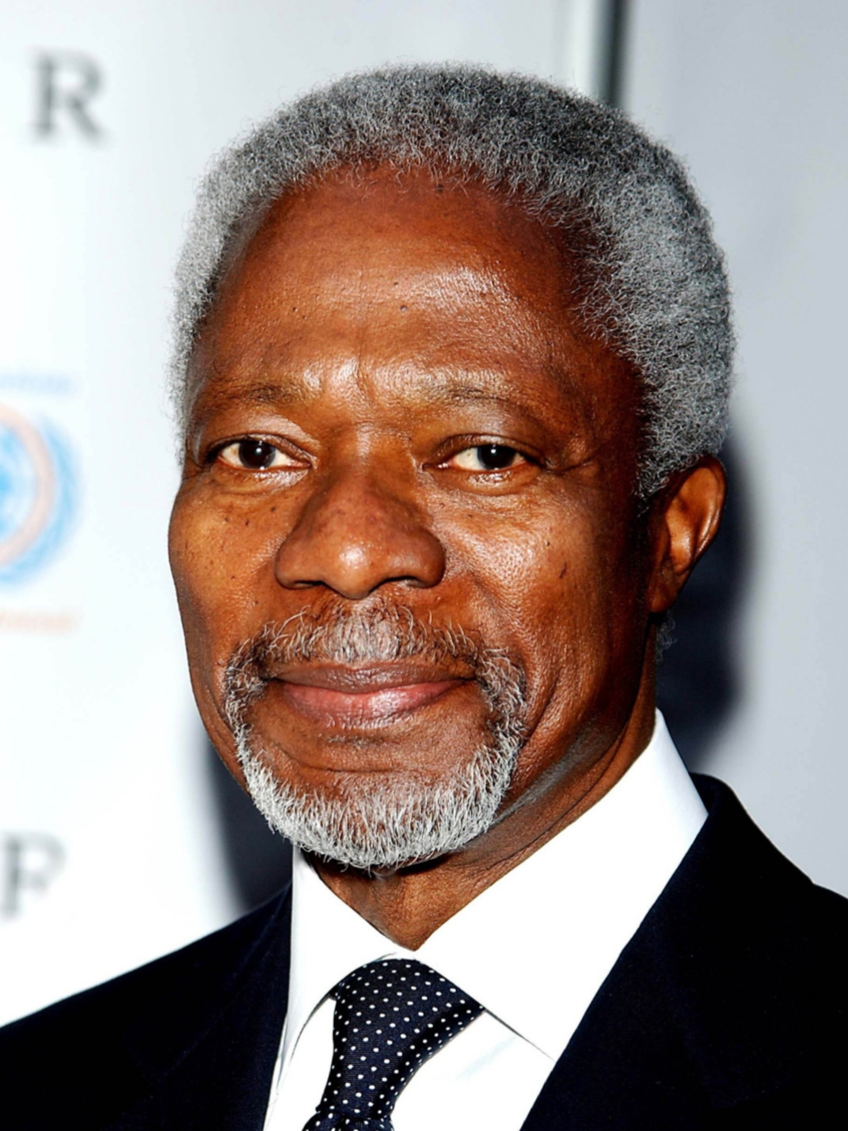
CONCLUSION
“Drugs are tearing apart our societies, spawning crimes, spreading diseases such as AIDS and killing our youth and our future and if you think that you and your family are immune , think again! Drugs are not a problem solely for the poor , the rich minorities or inner city residents. The drug problem affects everyone.”
KOFI ANNAN
FORMER UN SECRETARY GENERAL

